Slide 1
Bellabeat Case Study
How Can a Wellness Company Play It Smart?
Smart device data analysis -> marketing strategy
Google Data Analytics Capstone · Junior Data Analyst
Luca Mulazzi · June 2026

Slide 2
1 · ASK
The business problem
Analyze how consumers use fitness smart devices and turn the trends
into marketing recommendations for a Bellabeat product.
Guiding questions
Stakeholders
• What are the trends in smart device usage?
• How do they apply to Bellabeat customers?
• How can they influence marketing strategy?
• Urška Sršen — CCO, decision maker
• Sando Mur — cofounder
• Marketing Analytics team
2

Slide 3
2 · PREPARE
The data and its limitations
FitBit Fitness Tracker Data (Kaggle, CC0) — 33 users, Apr 12 – May 12, 2016
33
24
8
~31
activity
users
sleep
users
weight
users
days of
data
Limitations to keep in mind (ROCCC)
• Small, non-random sample; sleep and weight tracked by few users
• No demographic data (sex, age) — critical for a women's brand
• Data from 2016 and a single-month window
3

Slide 4
3 · PROCESS
Cleaning and preparing the data
Tools: Python · pandas · matplotlib · seaborn (Jupyter)
• Removed 3 duplicate rows from the sleep file
• Converted dates to explicit datetime format (no month/day ambiguity)
• Derived columns: weekday, active minutes, sedentary hours, hours asleep
• Isolated non-wear days (1440 sedentary min = 24h) to avoid skewing averages
• Documented, reproducible process, cell by cell in the notebook
4

Slide 5
4 · ANALYZE
The key numbers
8,280
15.8 h
6.9 h
avg steps / day
sedentary / day
sleep / night
below the 10k recommended
79% of tracked time
at the minimum (7-9h)
Relationships found
• More steps -> more calories burned (correlation +0.57)
• More sedentary hours -> less sleep (correlation -0.60)
• Sleep and weight under-tracked; wearers use it almost daily (29/33)
5

Slide 6
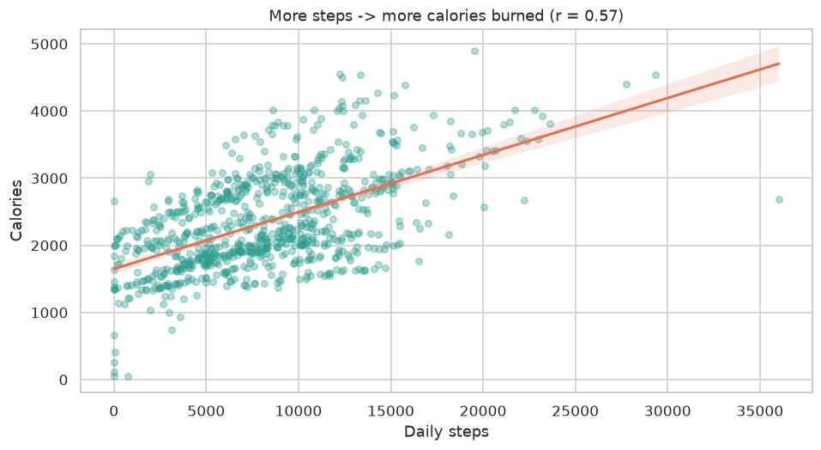
5 · SHARE
Movement and calories
Insight
Every step counts: those who walk more burn more calories.
A concrete motivational feedback to surface in the app.
6

Slide 7
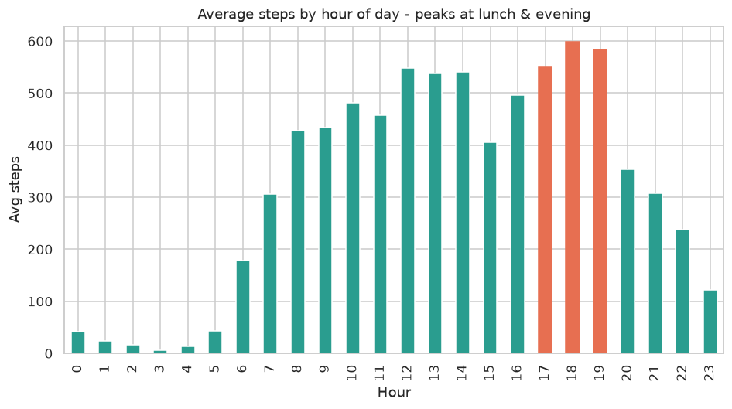
5 · SHARE
When people move
Insight
Activity peaks at lunch (12-2pm) and evening (5-7pm).
Ideal windows for notifications and campaigns.
7

Slide 8
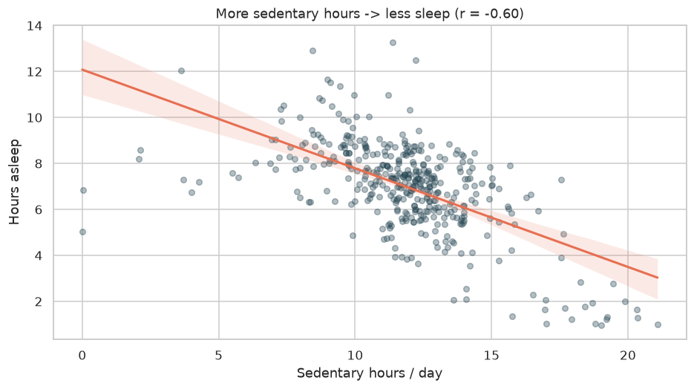
5 · SHARE
Sedentary vs sleep
Insight
More hours sitting, fewer hours of sleep.
A lever to connect daytime activity and rest quality.
8

Slide 9
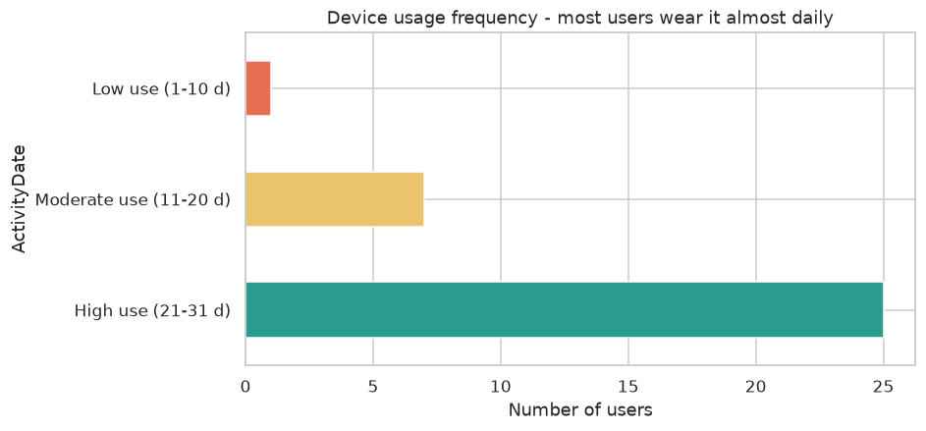
5 · SHARE
Loyal users
Insight
Most users wear the device 21-31 days.
Engagement must be nurtured, not won from scratch.
9

Slide 10
6 · ACT
Top 3 marketing recommendations
Chosen product: Bellabeat app (focus on Leaf / Time tracker)
1
Anti-sedentary campaign
Smart reminders in peak windows (12-2pm, 5-7pm) and realistic goals (+1,000 steps/day).
2
Sleep tracking as a flagship feature
"Move by day, sleep better at night": weekly reports and a lever for premium membership.
3
Data-driven marketing + gamification
Campaigns at peak-usage times and badges/streaks on the steps->calories feedback for retention and upsell.
10

Slide 11
Next steps
• Validate insights on larger, more recent data with female demographics
• A/B test notifications at peak times before rollout
• Integrate hydration (Spring) and menstrual cycle for the Bellabeat target
Thank you! · Luca Mulazzi
11

